Slide 1

Imaging for 3D Model in Discrete Element Method
Rasterization
Spatial Interpolation
Nanjing University
WEI Huajing
14/06/2020

Slide 2
Content
Background
Algorithm
Aim

Slide 3
Content
Background
Algorithm
Aim

Slide 4
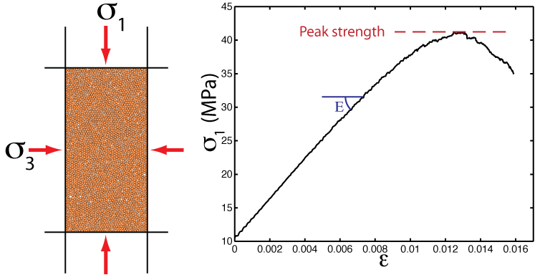
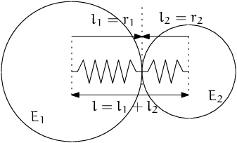
Background
DEM: Discrete Element Model
Microgranular system for macroscopic object
Based on Newtonian mechanics
Masses of computation

Slide 5
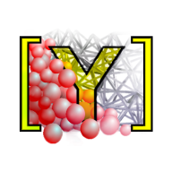
Software
YADE: Yet Another Dynamic Engine
Performed on Linux
Open Source
Python Command Line

Slide 6
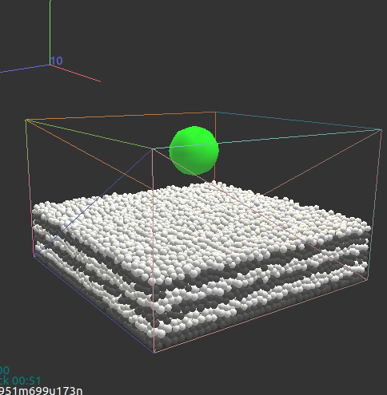
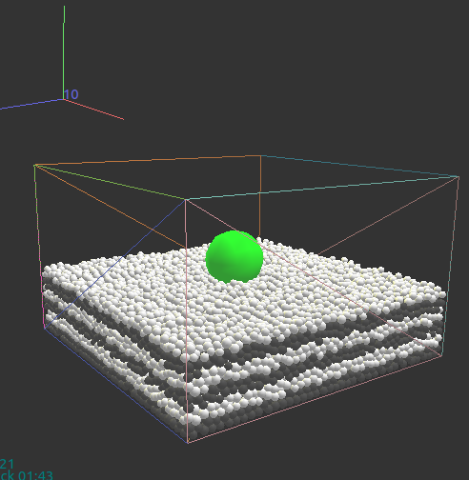
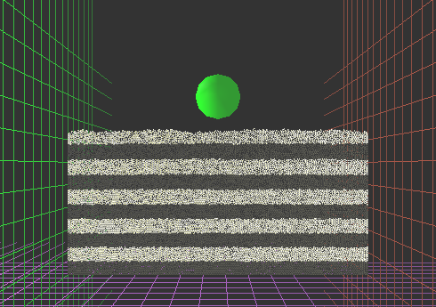
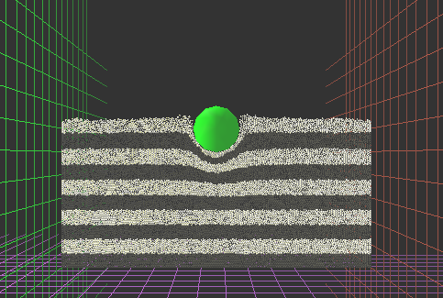
Scenario
Process of aerolite collision

Slide 7
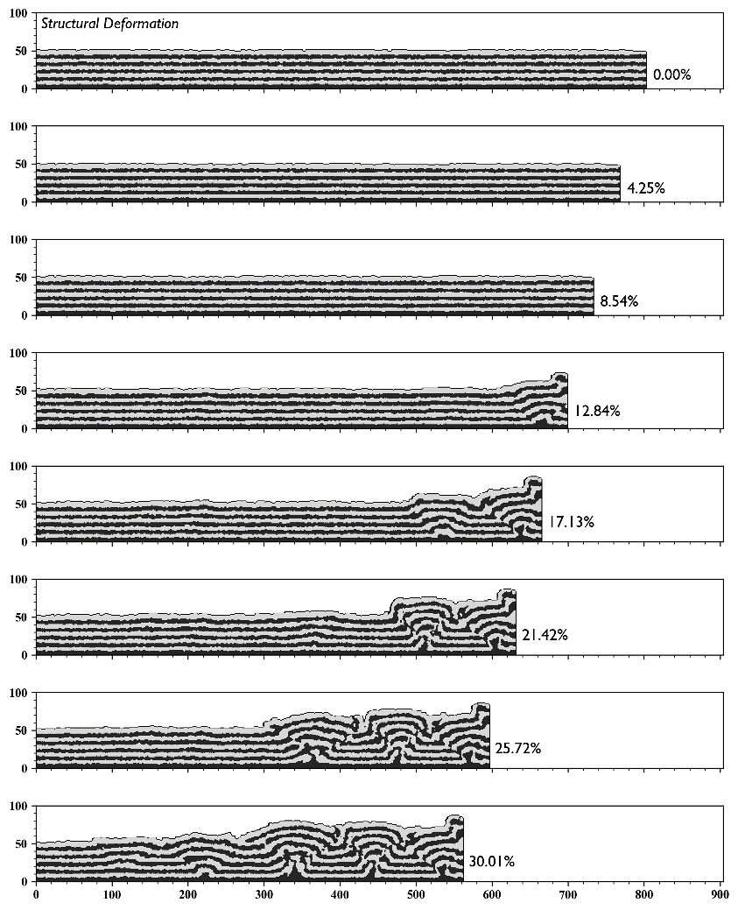
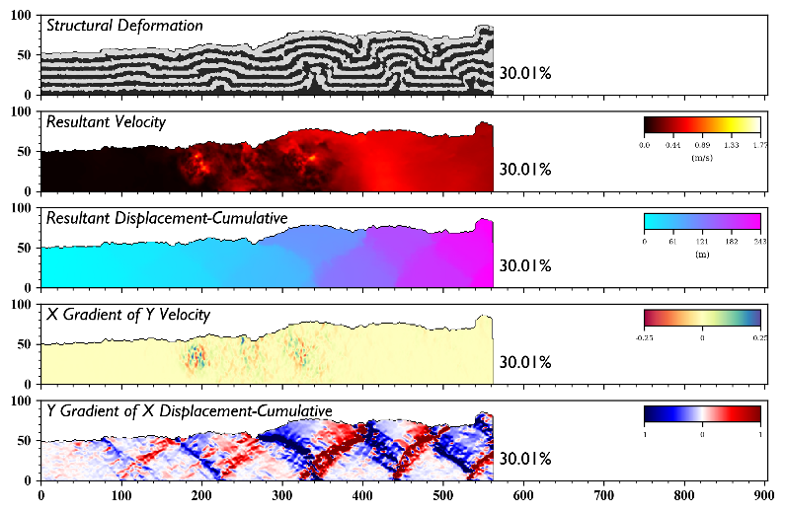
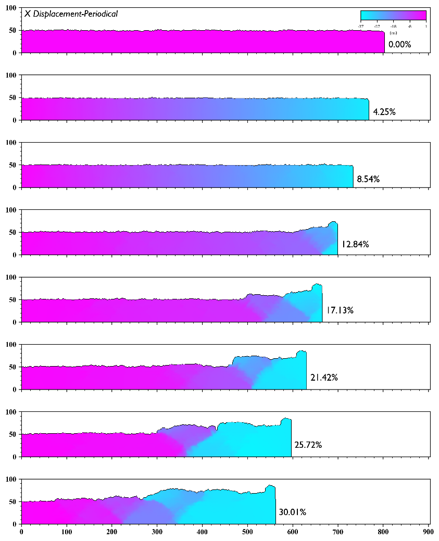
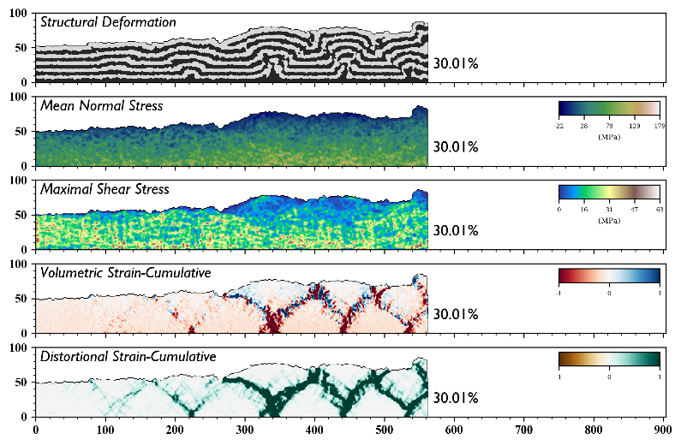
Imaging Effect

Slide 8
Content
Background
Algorithm
Aim

Slide 9

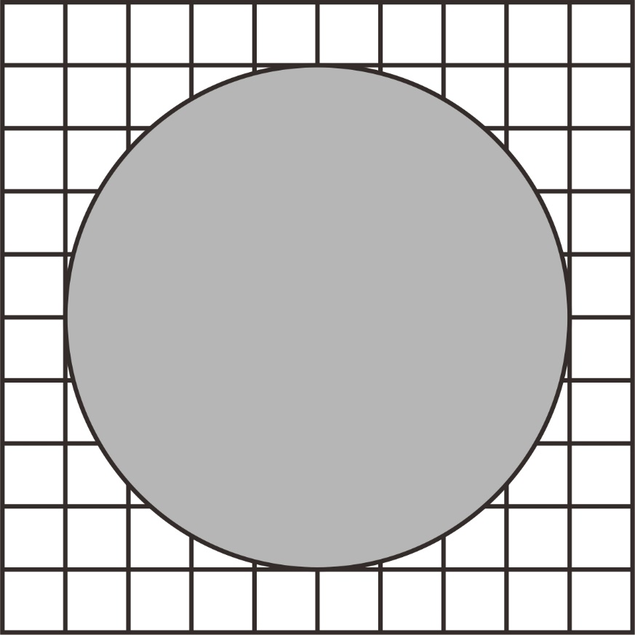
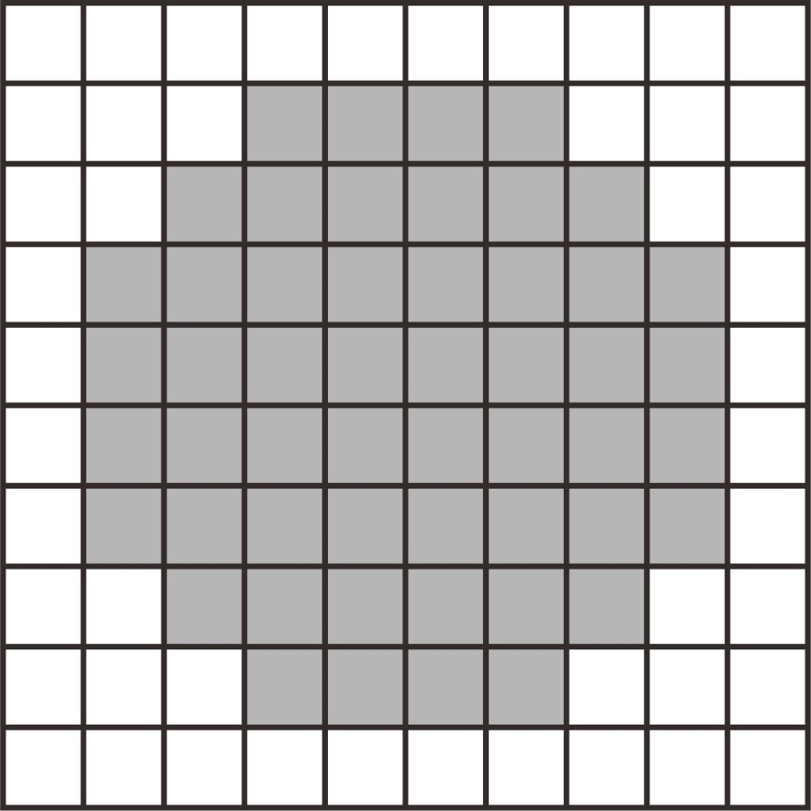


Rasterization
GitHub: https://github.com/jerryweihuajing/Post-Processing

Slide 10
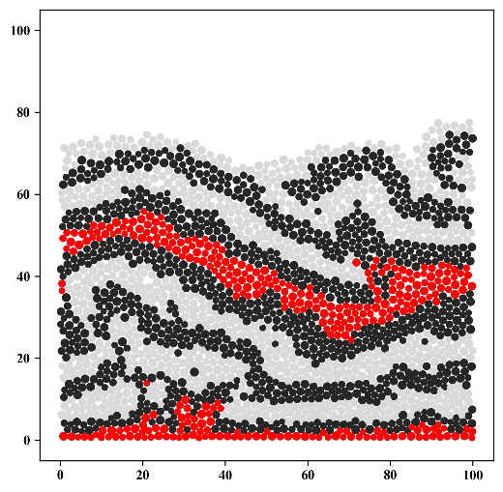
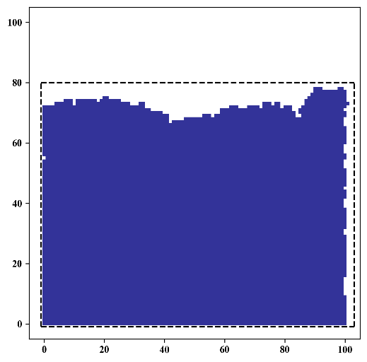
Rasterization
GitHub: https://github.com/jerryweihuajing/Post-Processing

Slide 11
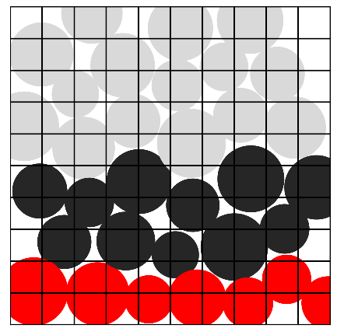
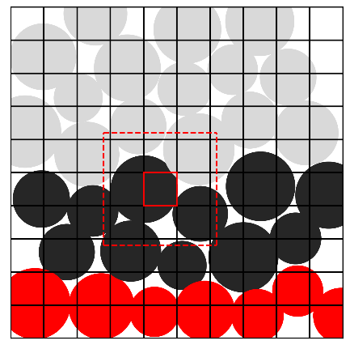
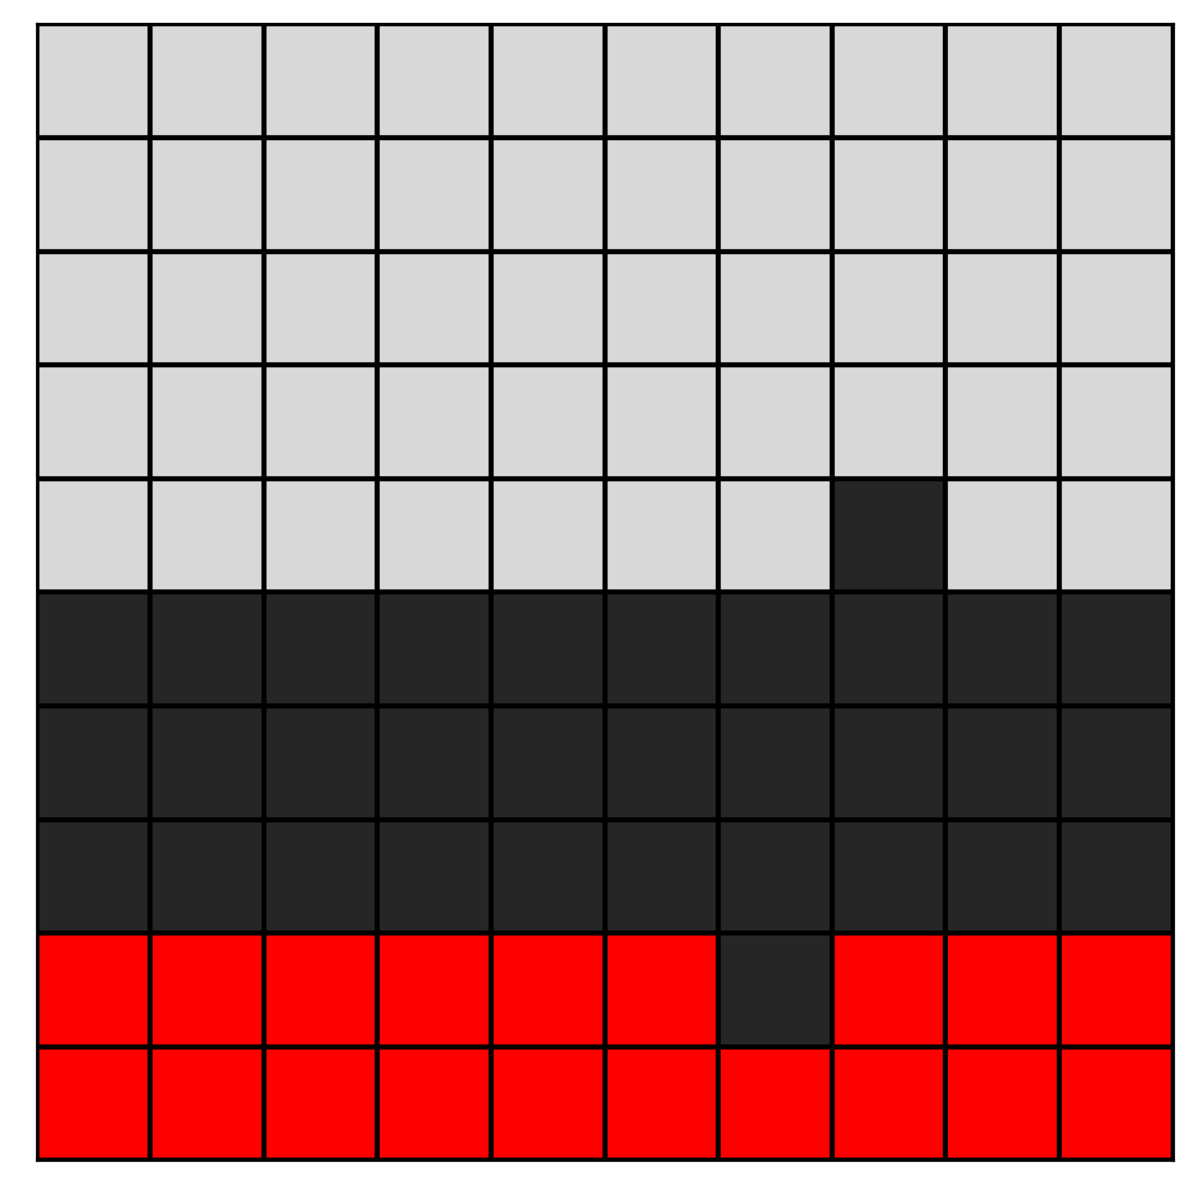
Rasterization
GitHub: https://github.com/jerryweihuajing/Post-Processing

Slide 12

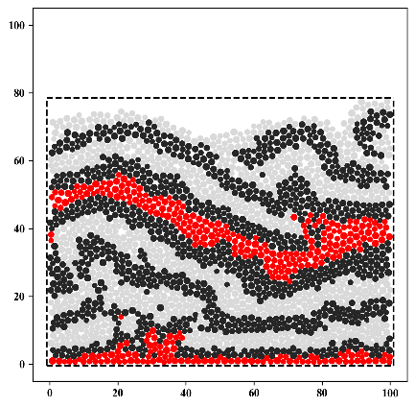
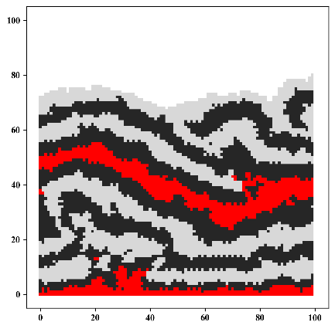
Rasterization
GitHub: https://github.com/jerryweihuajing/Post-Processing

Slide 13
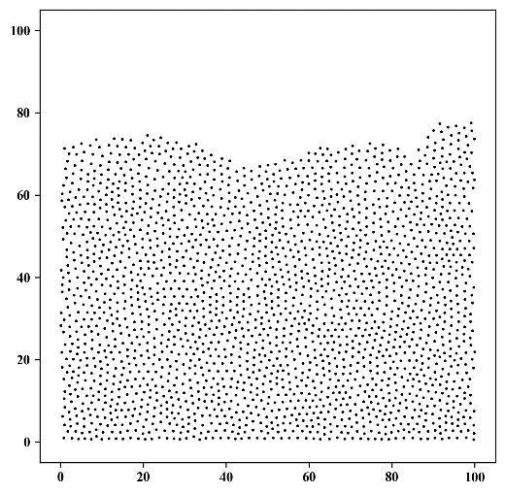
Spatial Interpolation
GitHub: https://github.com/jerryweihuajing/Post-Processing

Slide 14
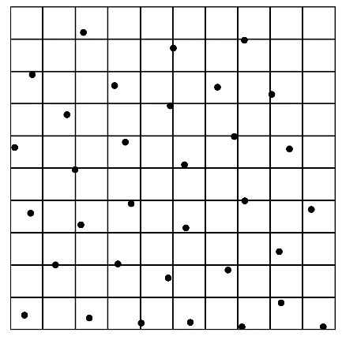
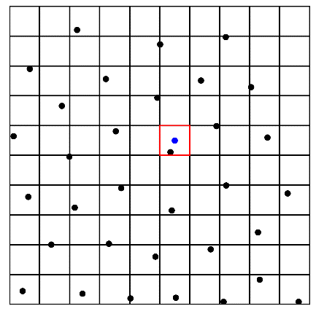
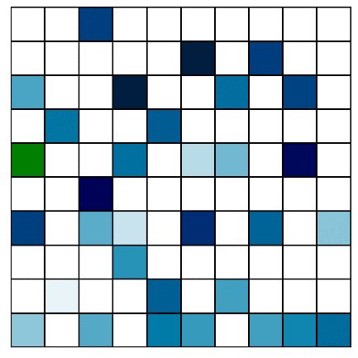
Spatial Interpolation
GitHub: https://github.com/jerryweihuajing/Post-Processing

Slide 15
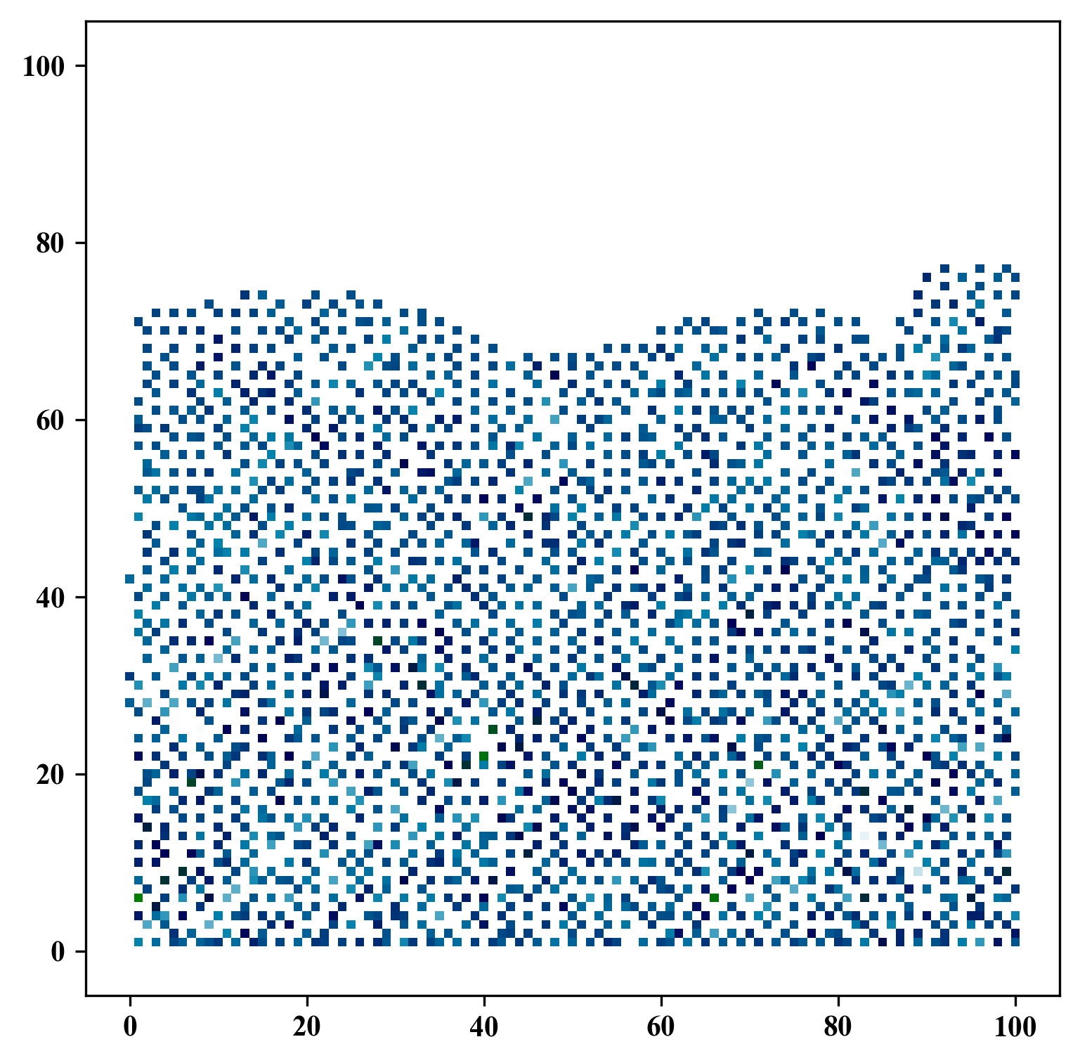
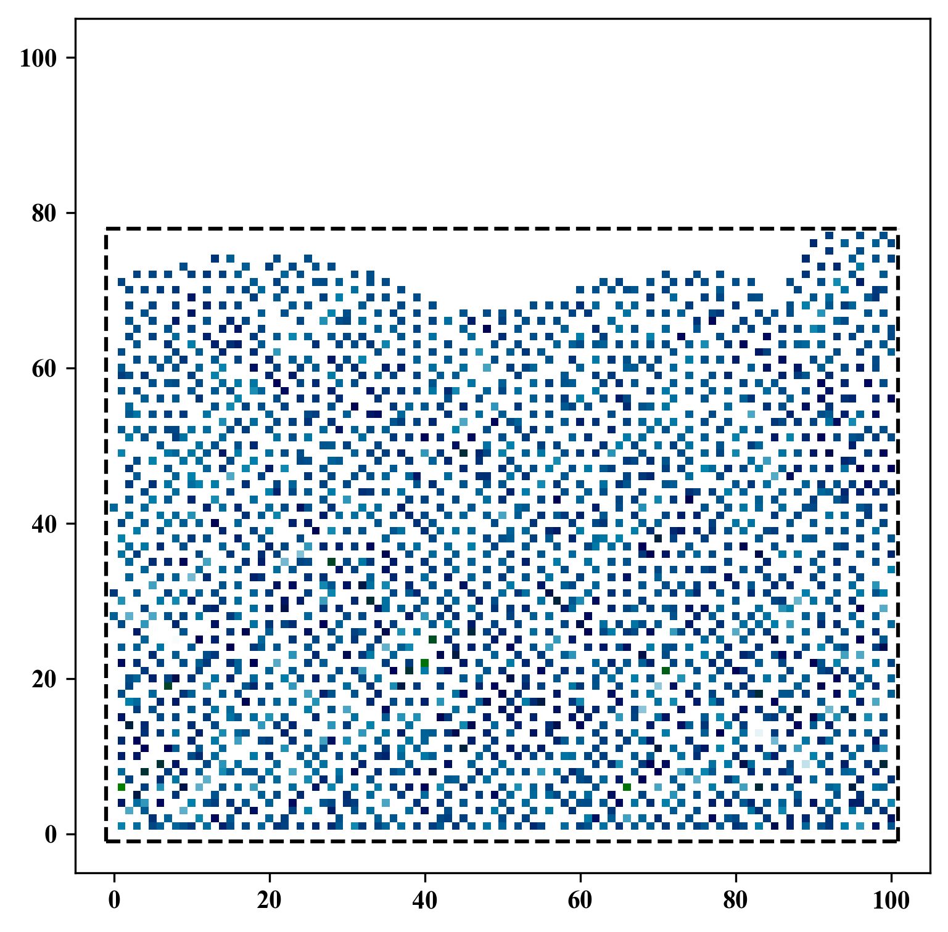
Spatial Interpolation
GitHub: https://github.com/jerryweihuajing/Post-Processing

Slide 16
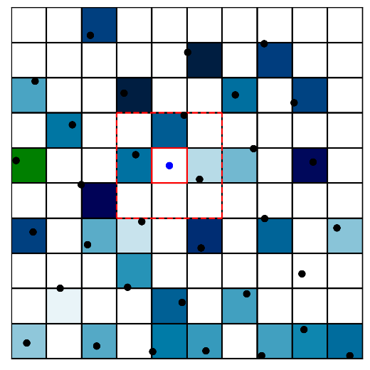
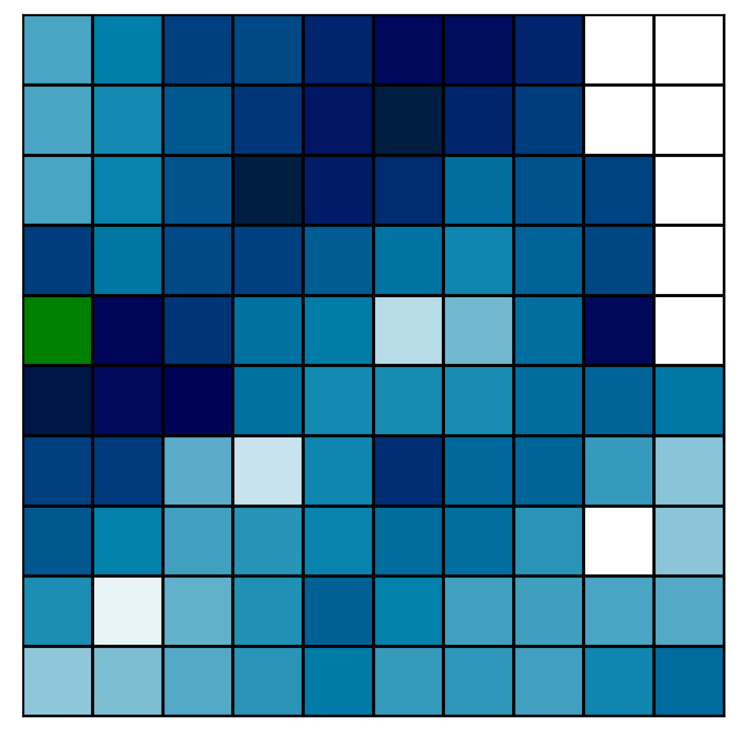
Spatial Interpolation
GitHub: https://github.com/jerryweihuajing/Post-Processing

Slide 17
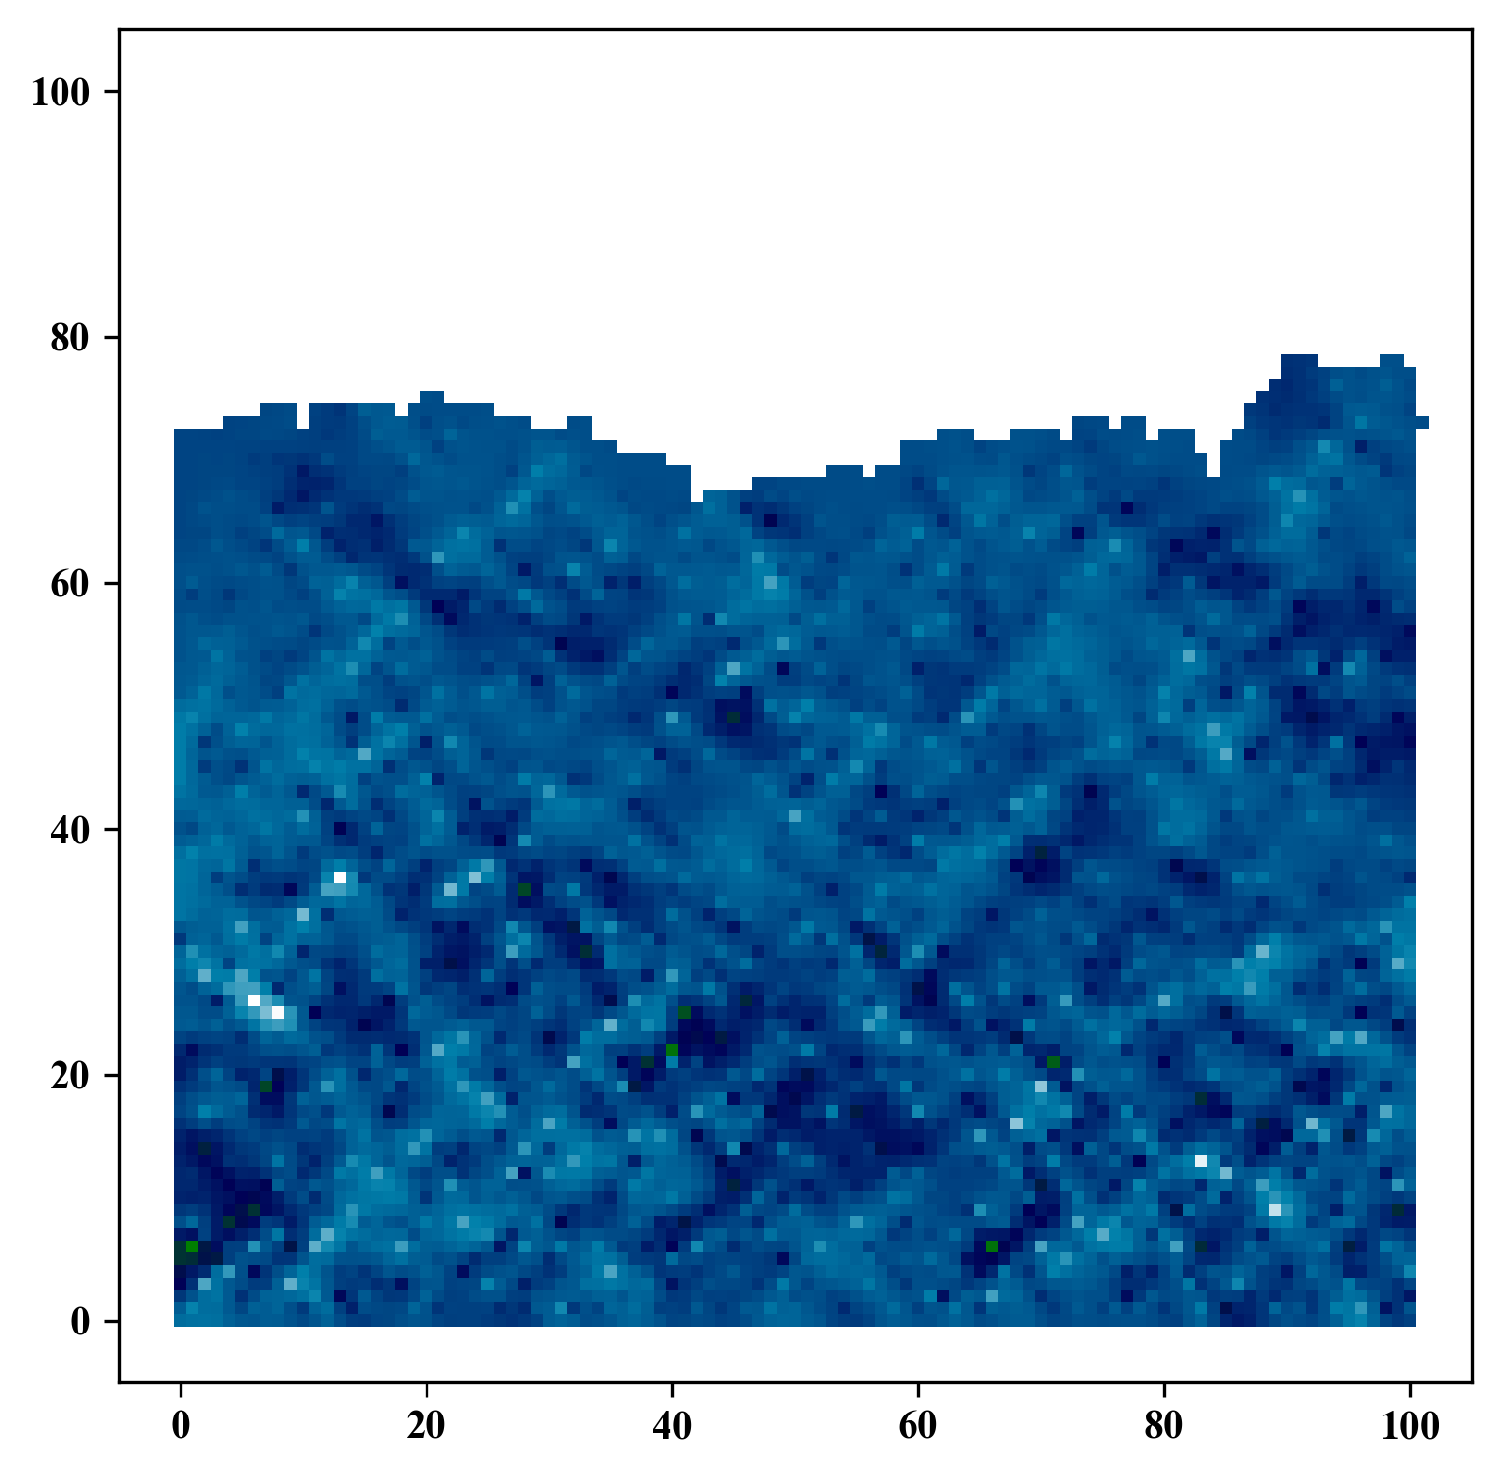
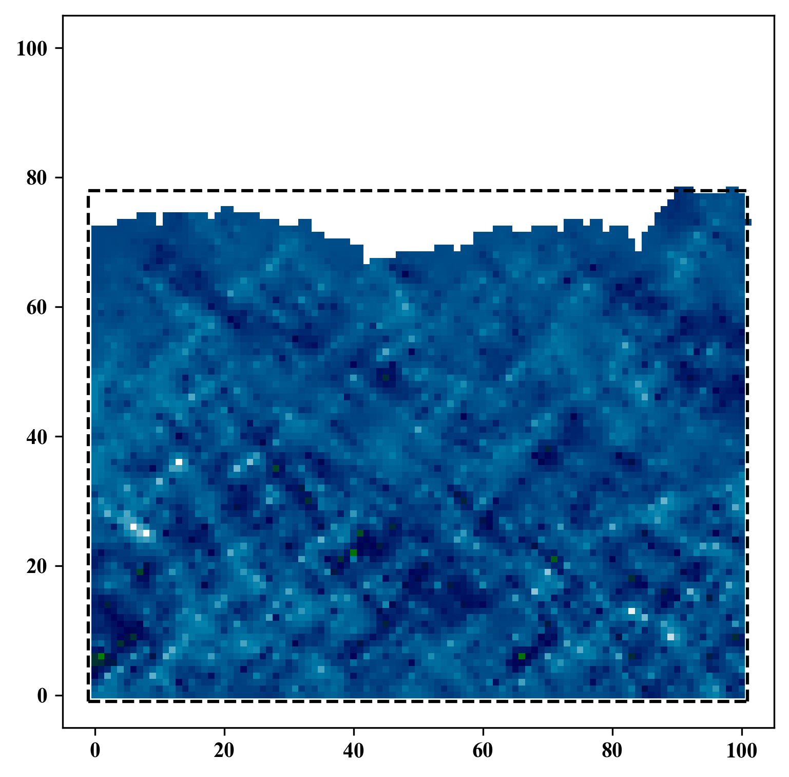
Spatial Interpolation
GitHub: https://github.com/jerryweihuajing/Post-Processing

Slide 18
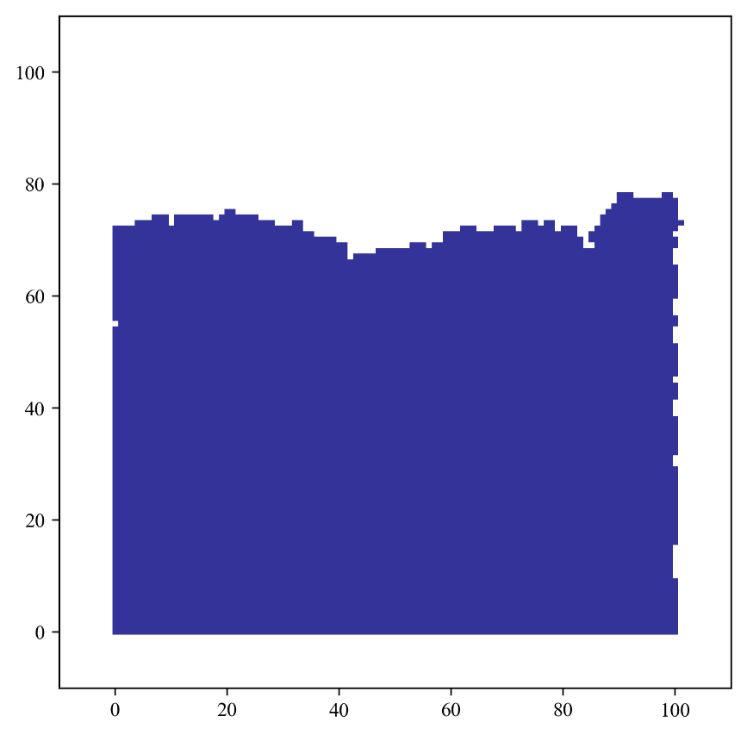
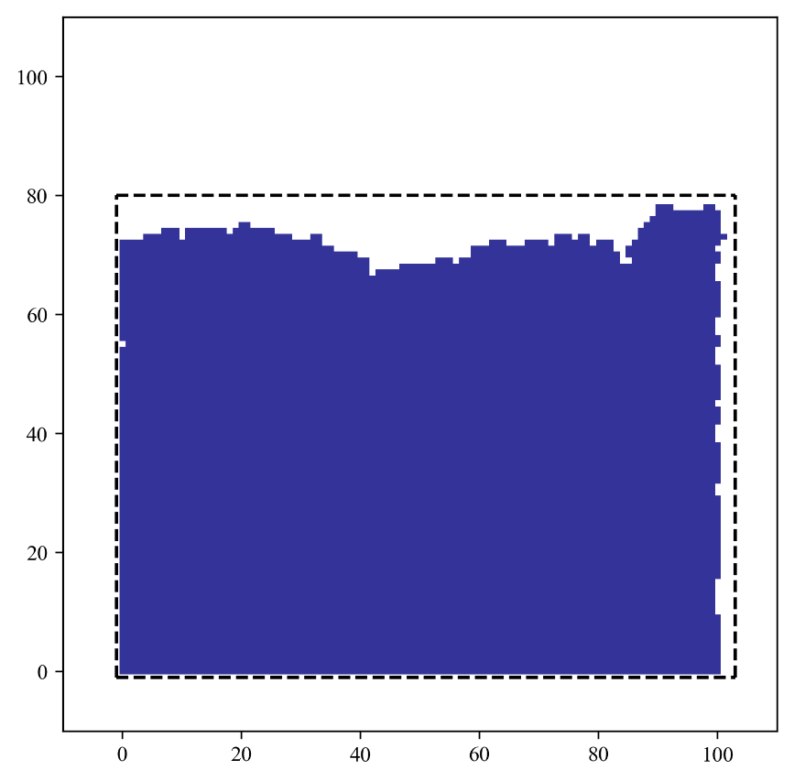
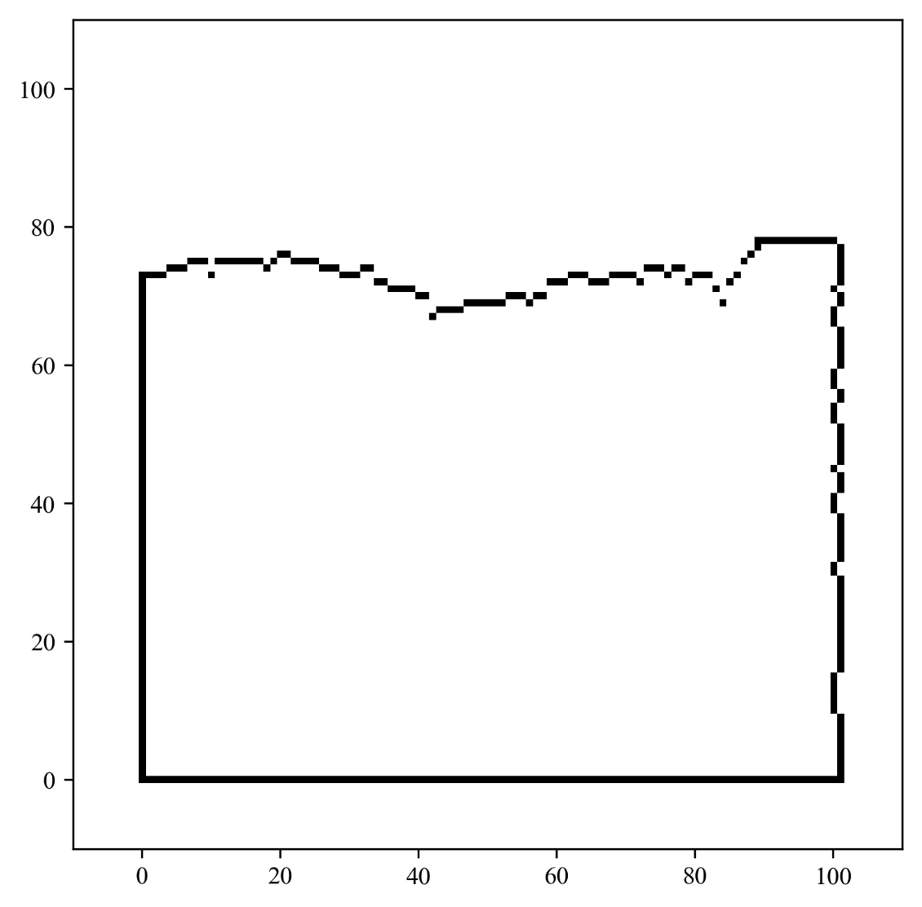
Boundary Extraction
GitHub: https://github.com/jerryweihuajing/Post-Processing

Slide 19
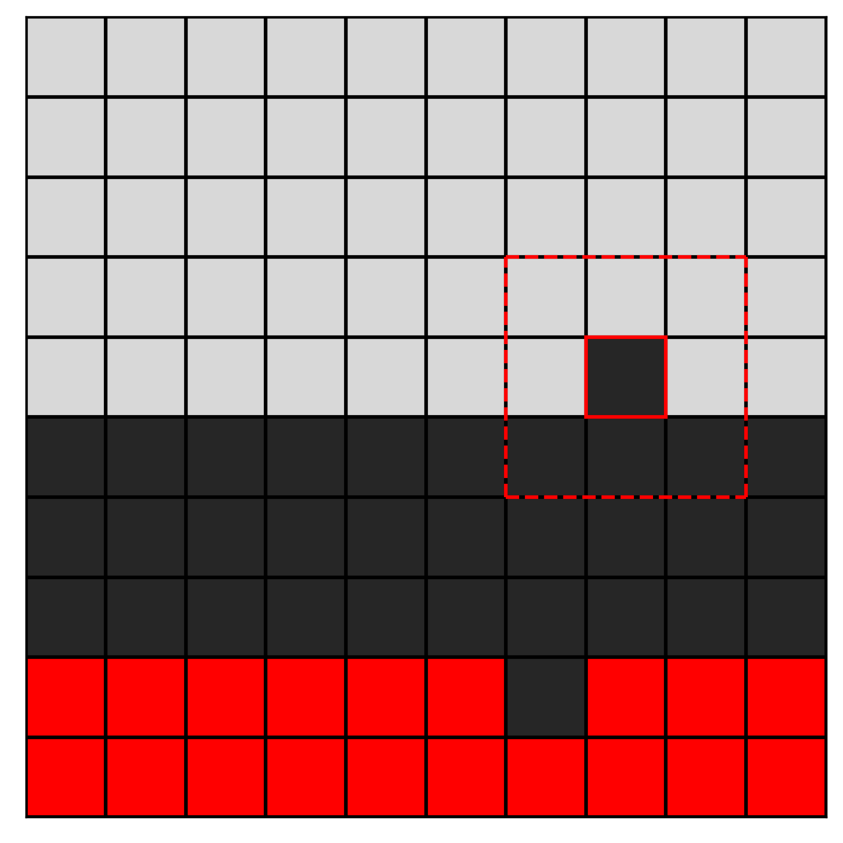
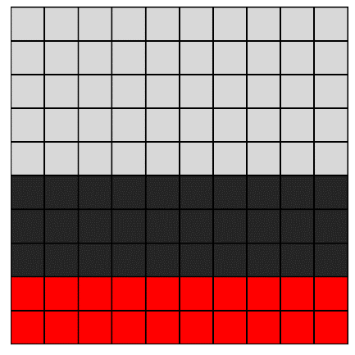
Gaussian Filtering
GitHub: https://github.com/jerryweihuajing/Post-Processing

Slide 20

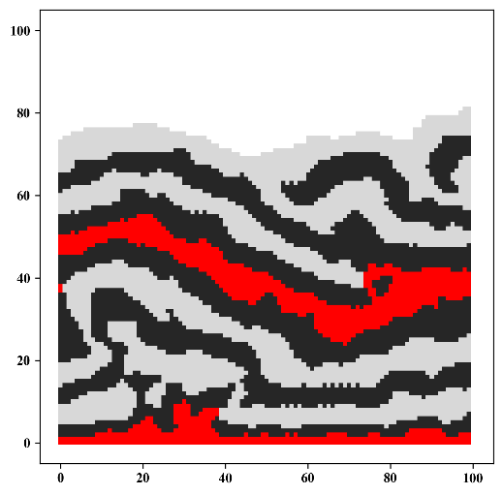
Gaussian Filtering
GitHub: https://github.com/jerryweihuajing/Post-Processing

Slide 21
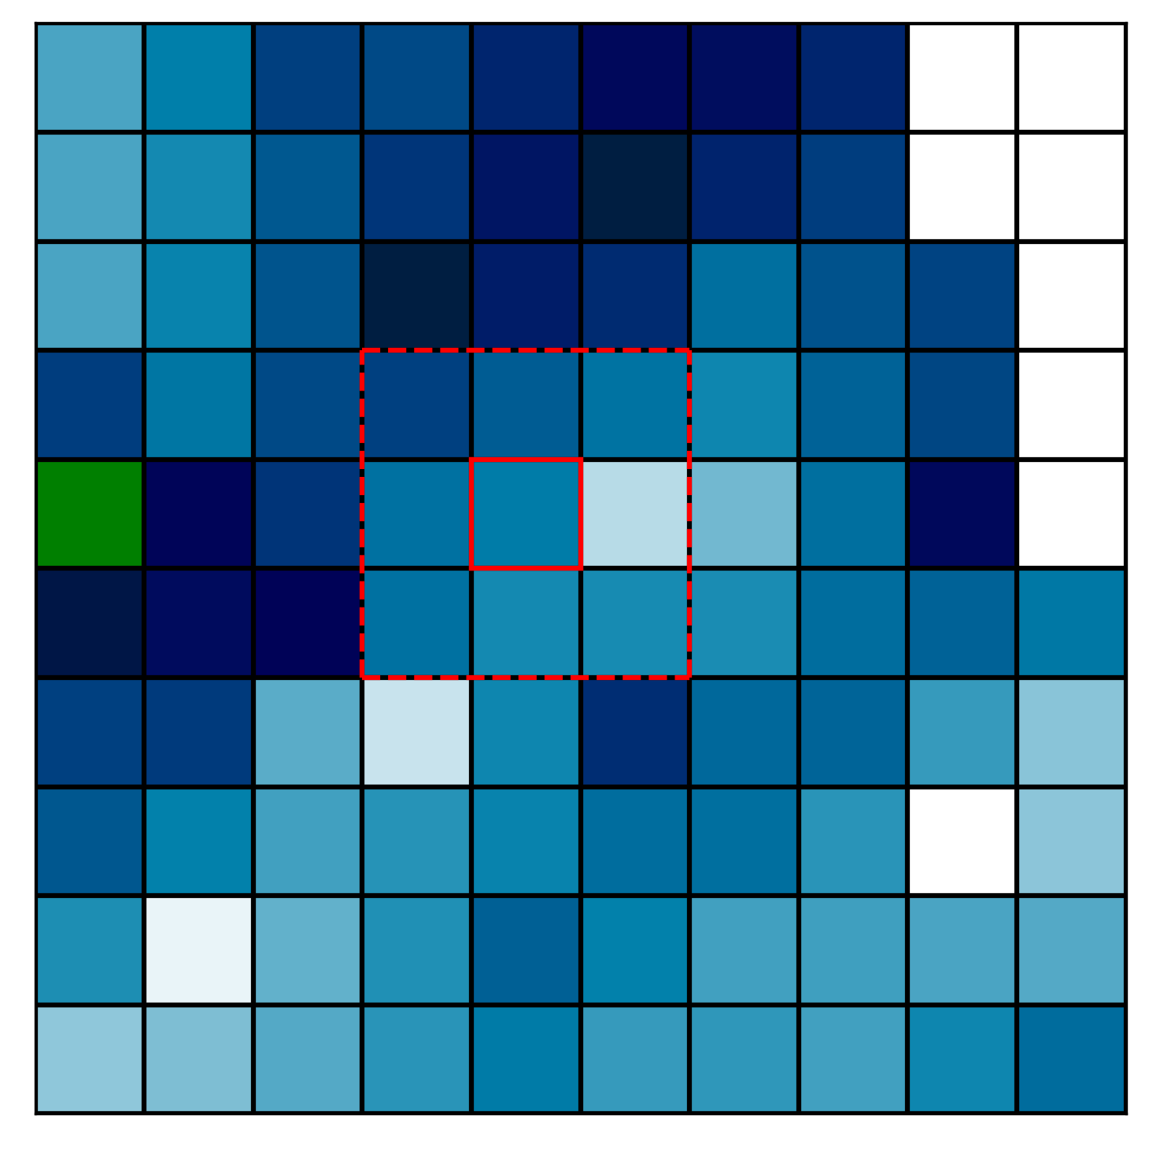
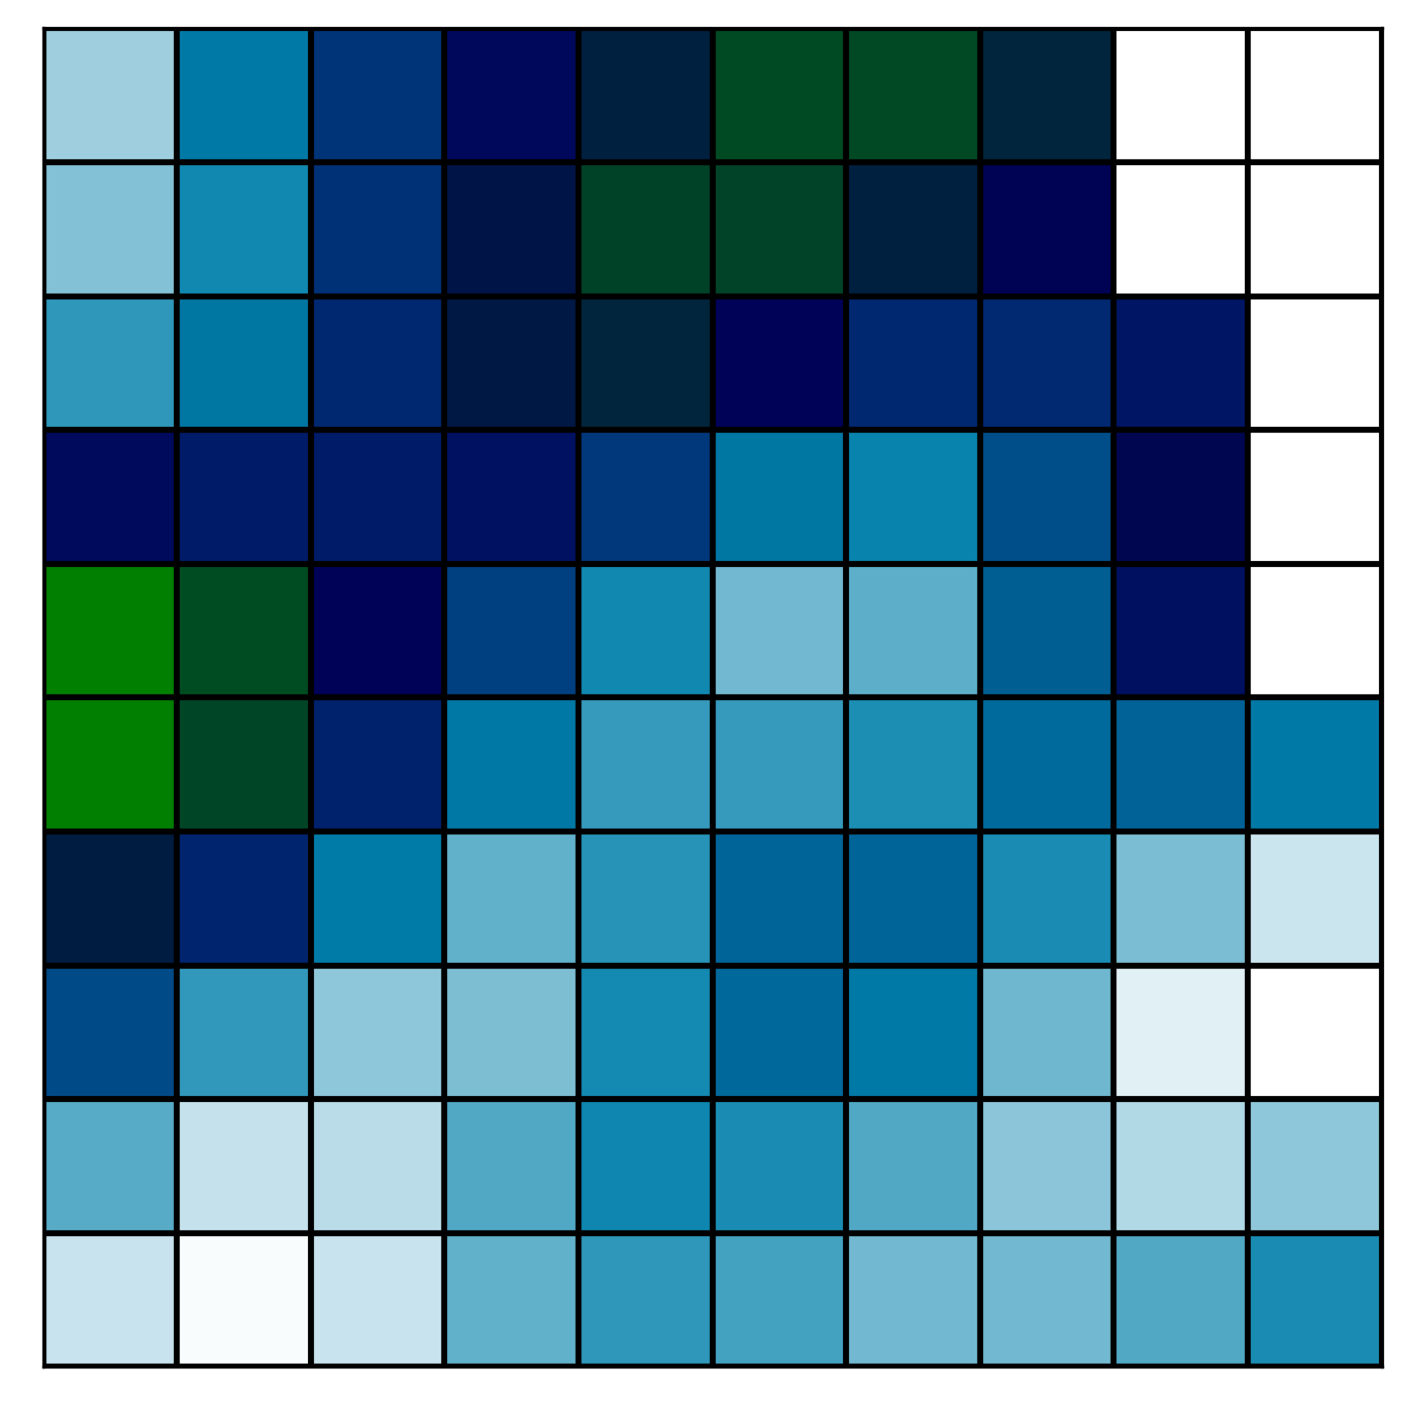
Gaussian Filtering
GitHub: https://github.com/jerryweihuajing/Post-Processing

Slide 22
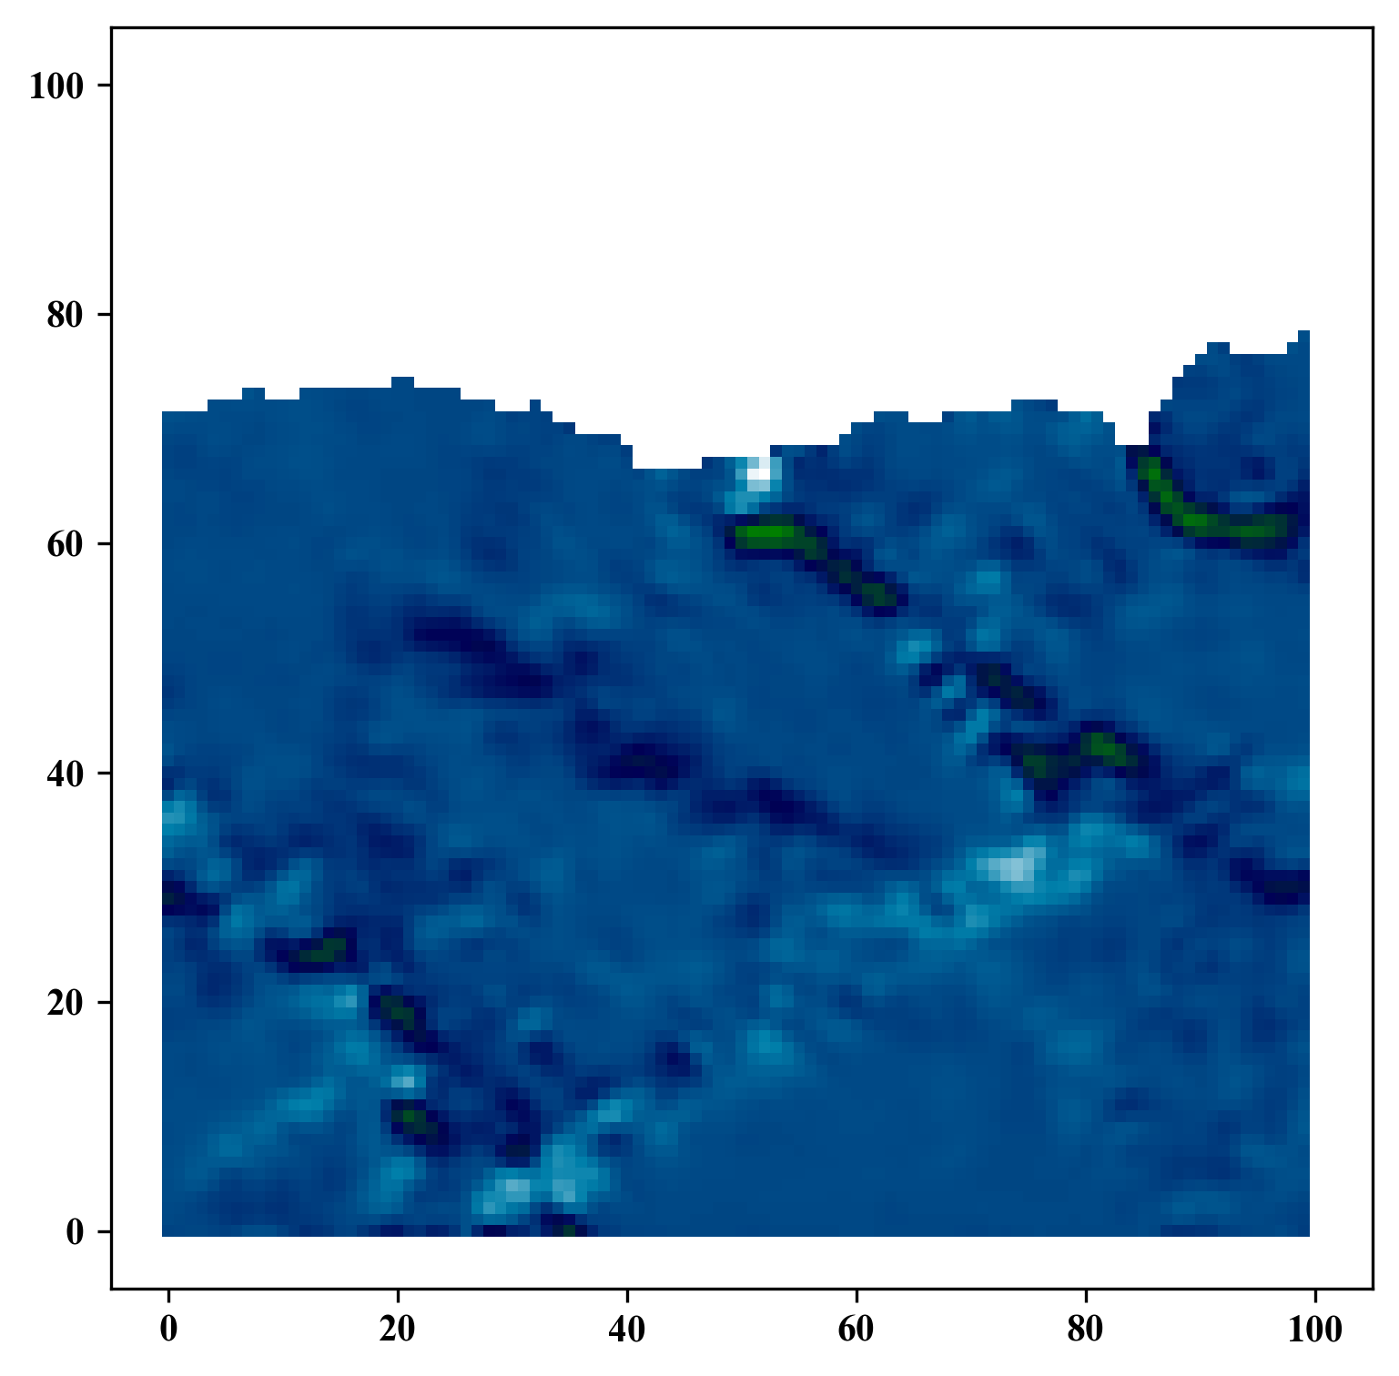
Gaussian Filtering
GitHub: https://github.com/jerryweihuajing/Post-Processing

Slide 23
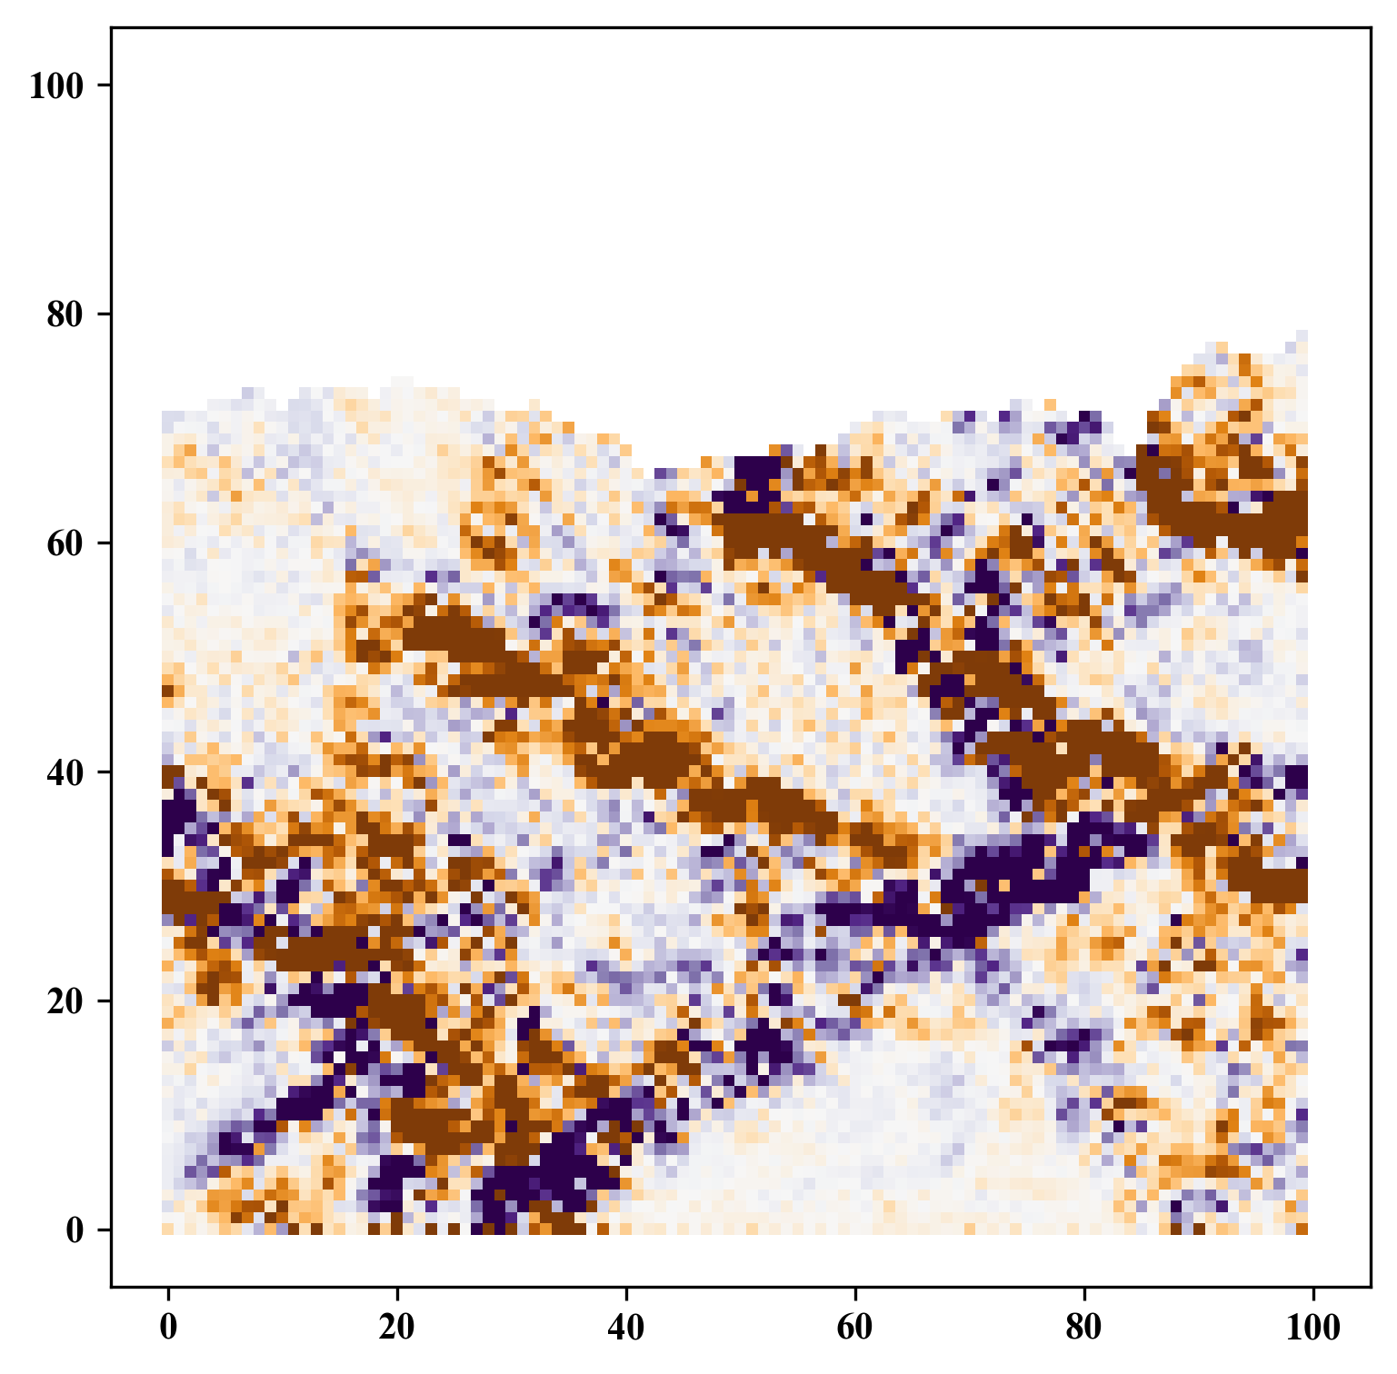
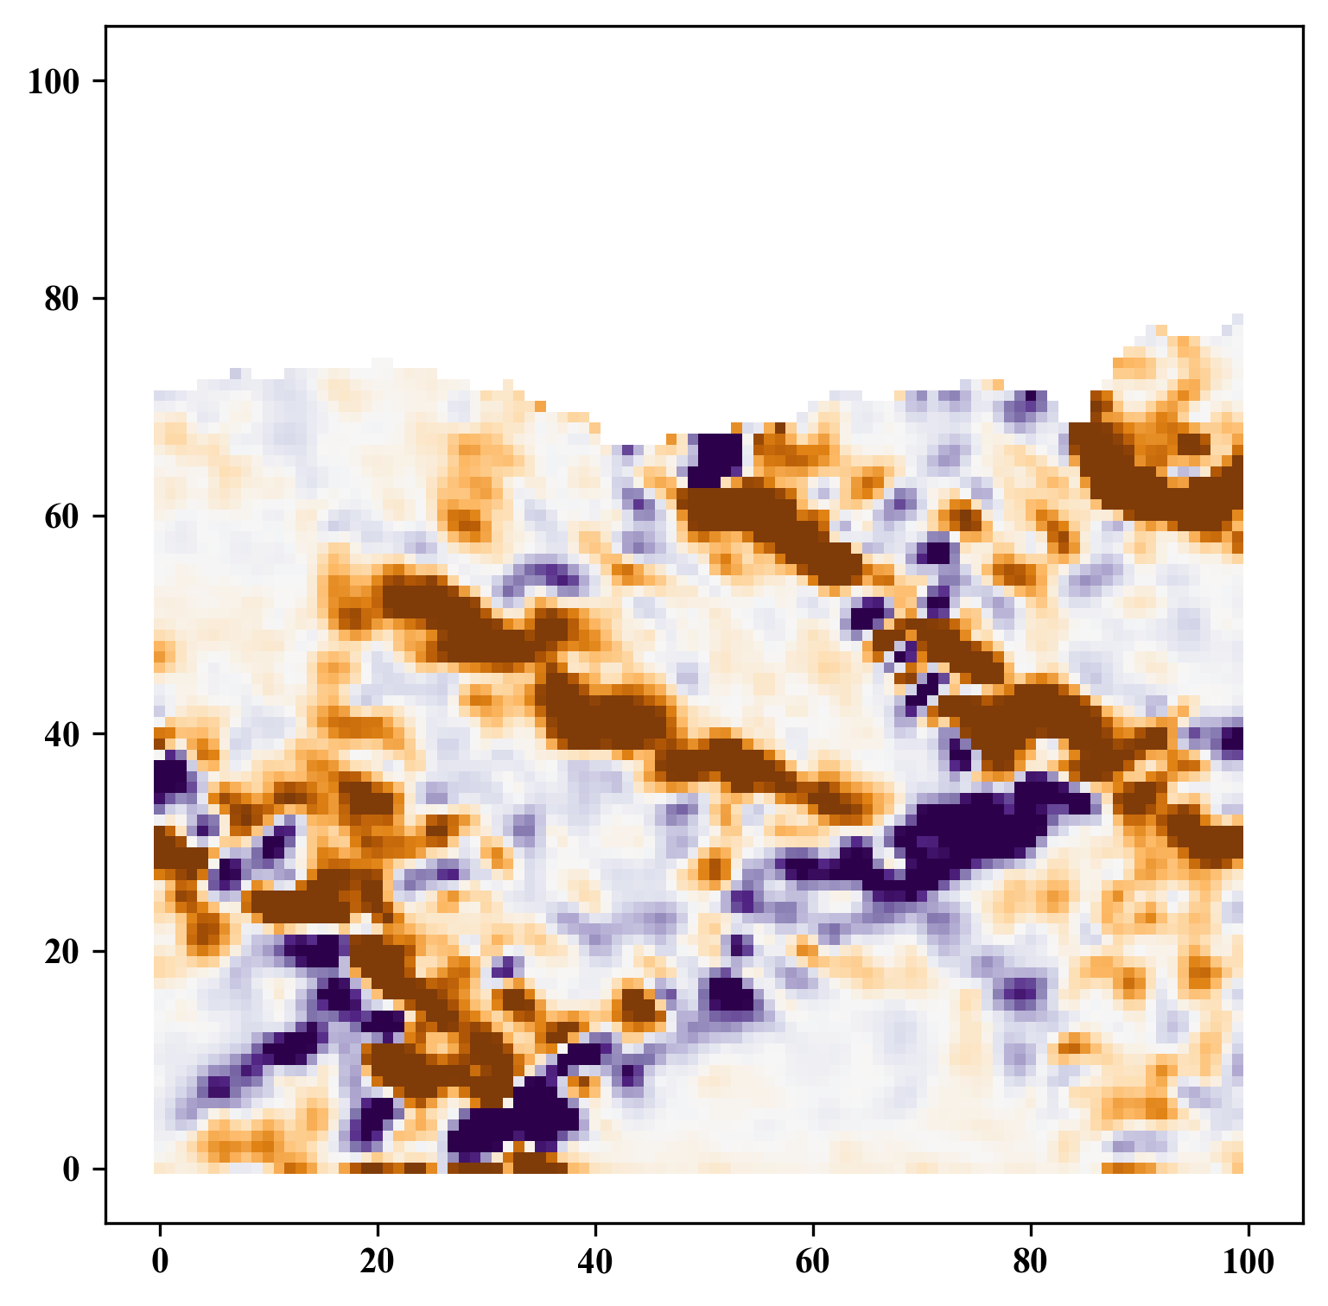
Gaussian Filtering
GitHub: https://github.com/jerryweihuajing/Post-Processing

Slide 24
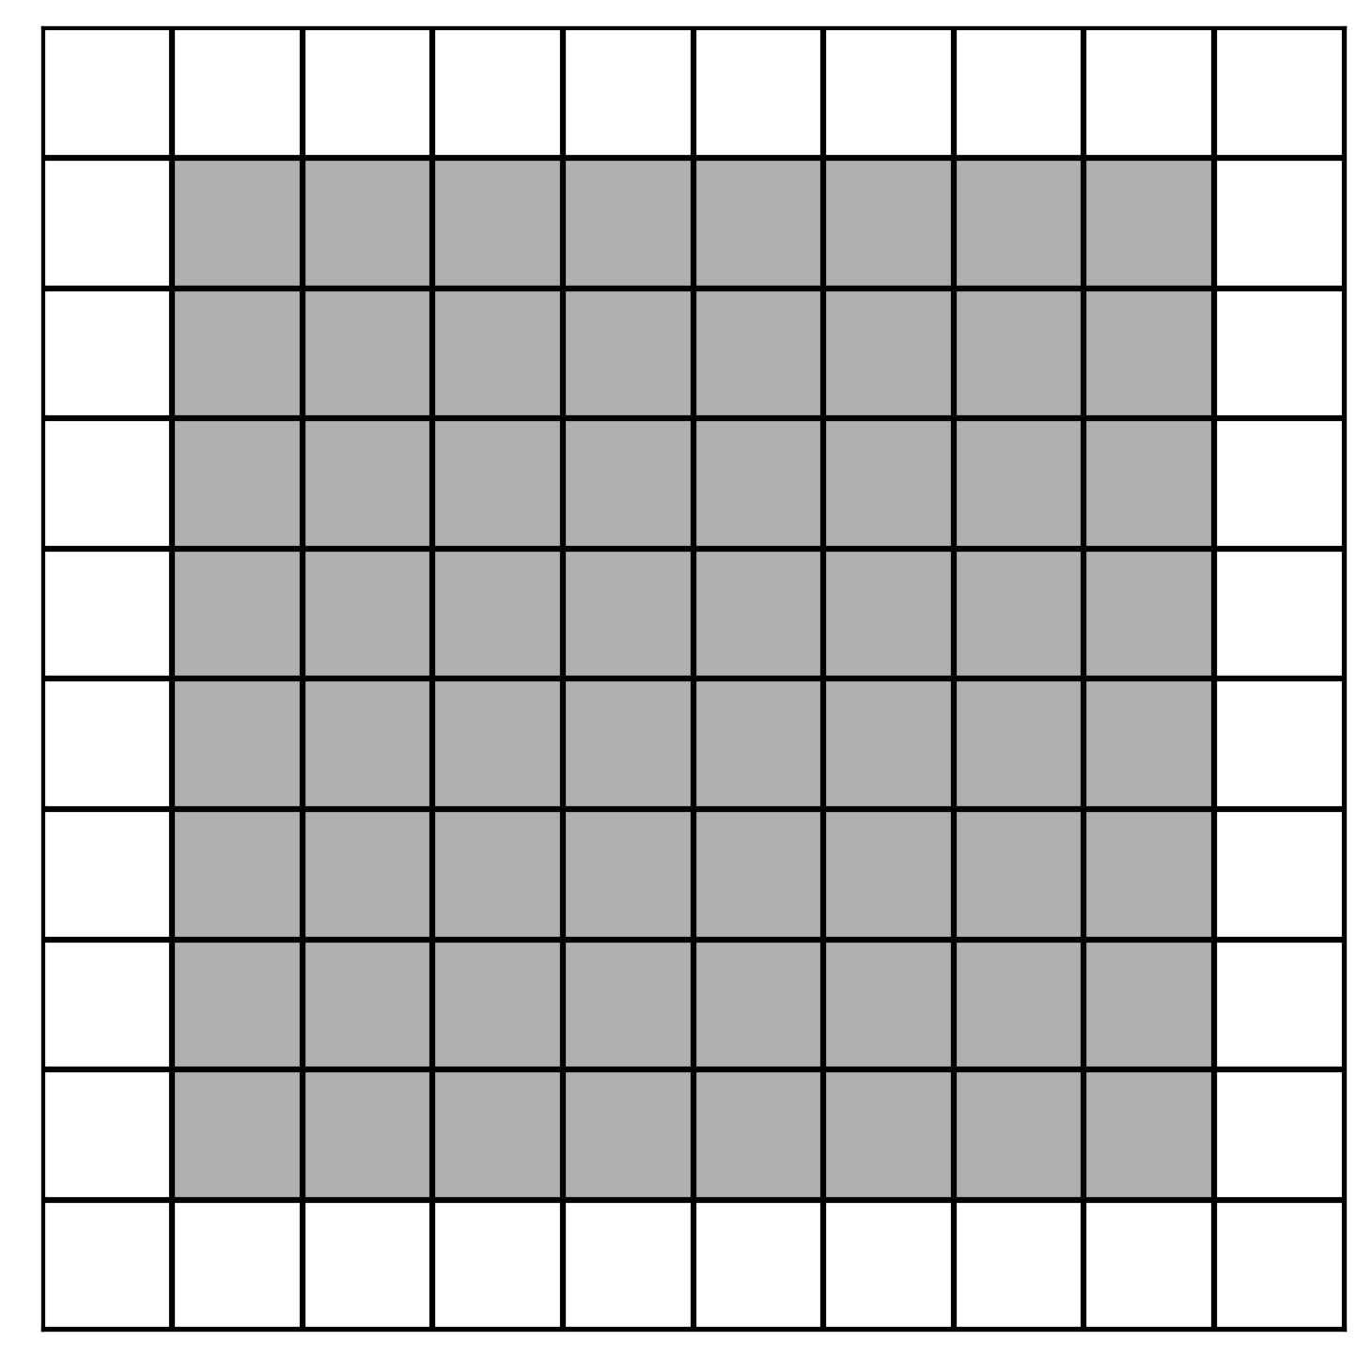
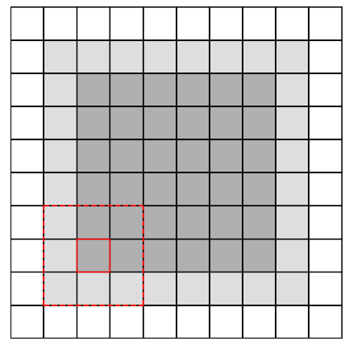
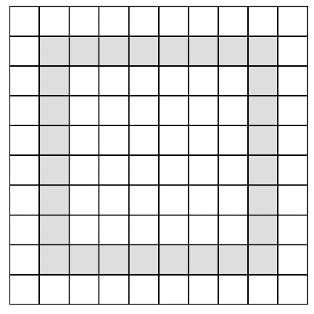
Boundary Extraction
GitHub: https://github.com/jerryweihuajing/Post-Processing

Slide 25
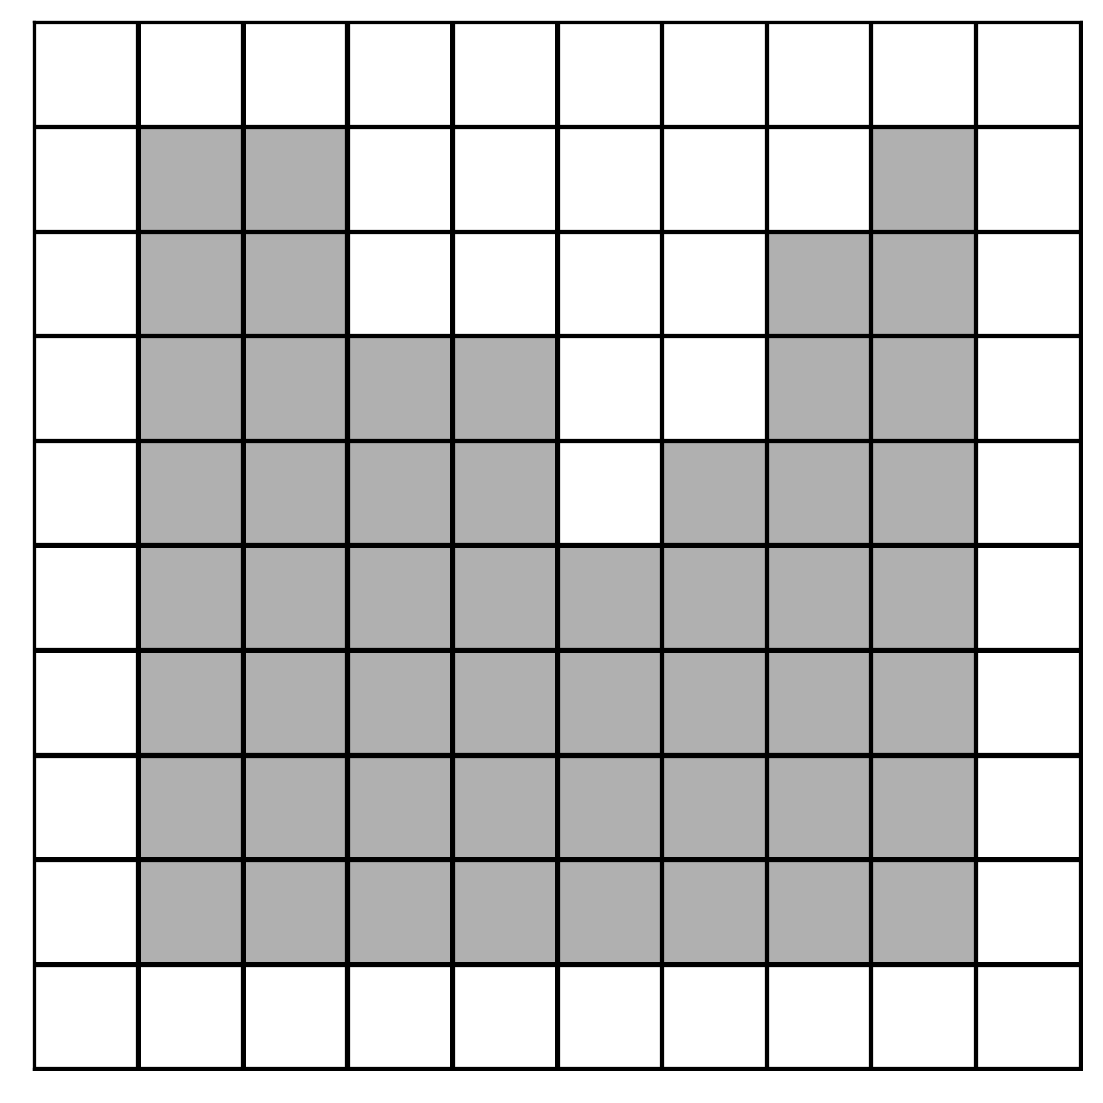
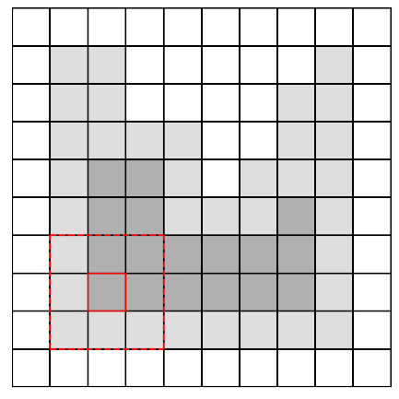
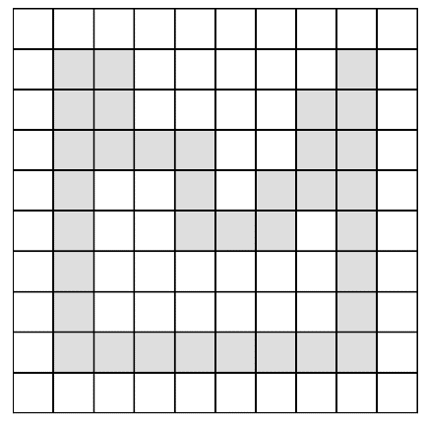
Boundary Extraction
GitHub: https://github.com/jerryweihuajing/Post-Processing

Slide 26
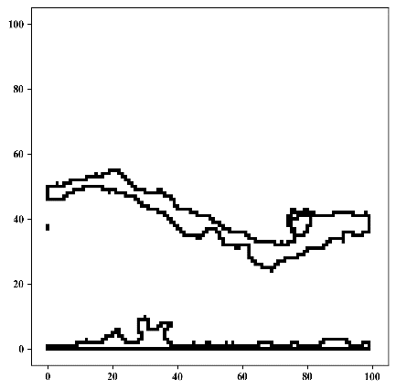
Boundary Extraction
GitHub: https://github.com/jerryweihuajing/Post-Processing

Slide 27
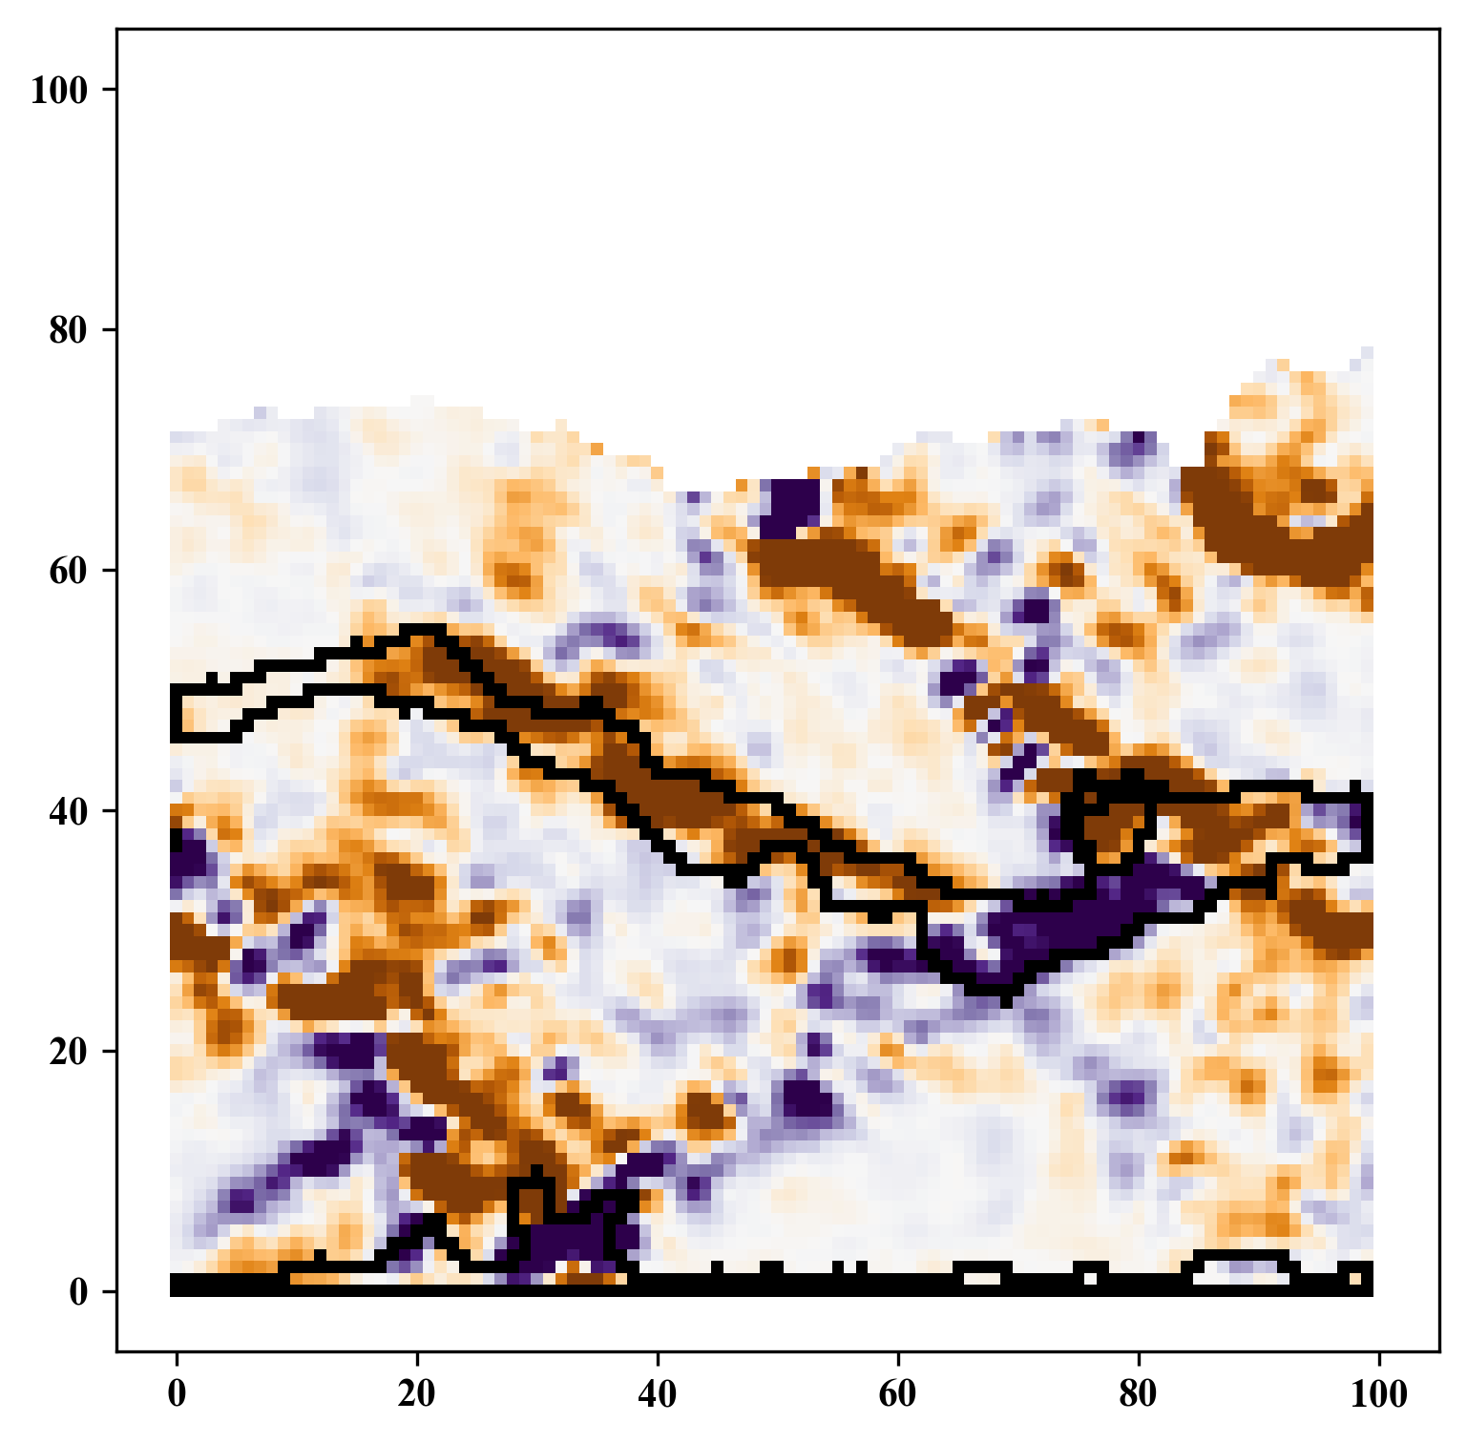
Boundary Extraction
GitHub: https://github.com/jerryweihuajing/Post-Processing

Slide 28
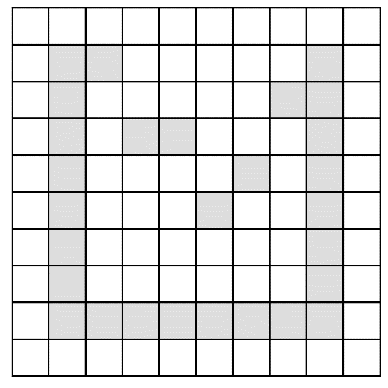
Outline Calculation
GitHub: https://github.com/jerryweihuajing/Post-Processing

Slide 29


Outline Calculation
GitHub: https://github.com/jerryweihuajing/Post-Processing

Slide 30



Outline Calculation
GitHub: https://github.com/jerryweihuajing/Post-Processing

Slide 31

Outline Calculation
GitHub: https://github.com/jerryweihuajing/Post-Processing

Slide 32
Content
Background
Algorithm
Aim

Slide 33
Aim
Viewing Transformation
(Circle) Rasterization
Spatial Interpolation
Z-Buffering

Slide 34
Acknowledgement
THANKS

